Slide 1
Autonomous Decision-Making for Large Satellite Constellations: a Multi-Agent Reinforcement Learning Approach to Space Situational Awareness in Partially Observable Dynamic Environments
Clemente J. Juan Oliver
11th European Conference for AeroSpace Sciences (EUCASS)
Rome, 03.07.2025

Slide 2






Increasingly crowded orbits
… and workloads
Maintenance
Install
Repair
Monitoring and Control
Monitor positions
Managing communications
Troubleshooting
Diagnostics
Resolve problems
Coordination
Manage conjunctions
Avoid collisions
Minimize downtime
Maintain Service Quality

Slide 3



Can Deep Reinforcement Learning (DRL) help reduce workloads and enhance Space Situational Awareness (SSA)?
How do we improve monitoring of other satellites and debris?
Can we use DRL to autonomously manage a constellation of observer satellites?

Slide 4
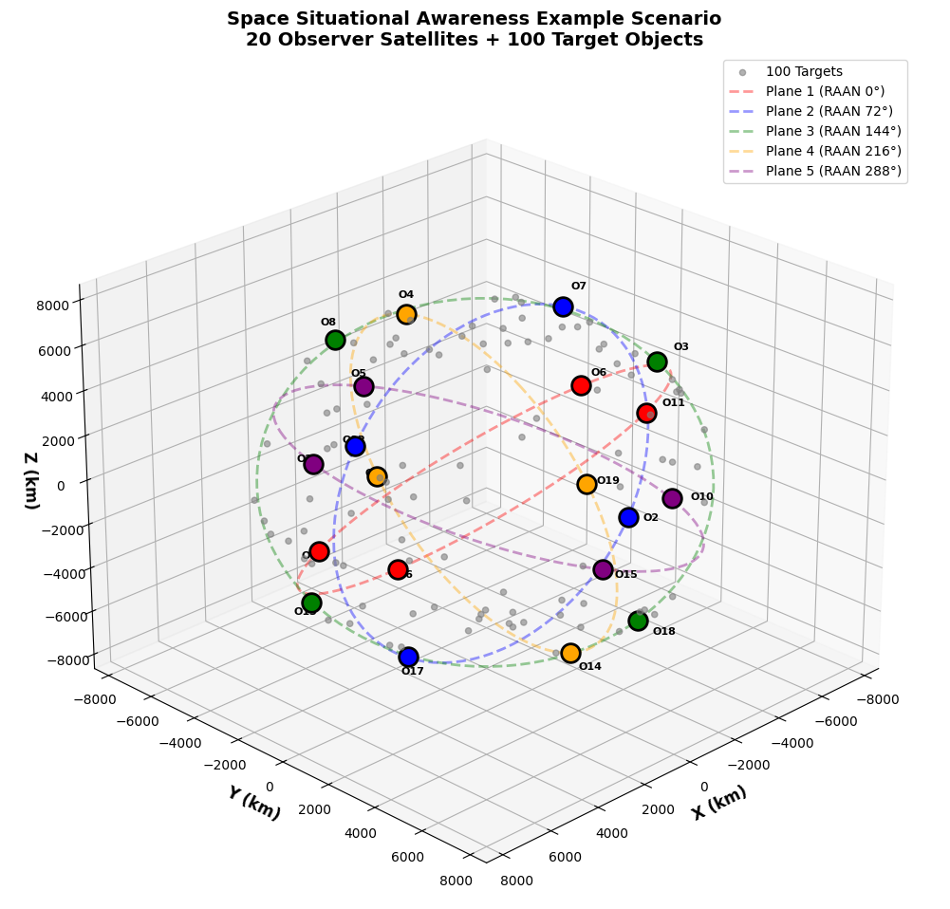
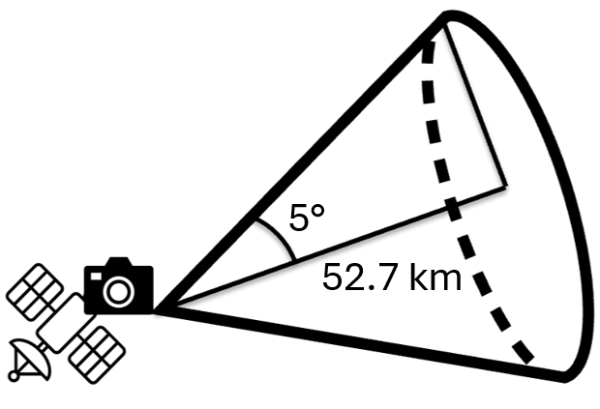



Mission Goal: Detect and Monitor All Target Objects
Observer Satellites
20 participants
Walker-Delta constellation with 5 planes (20/5/1)
700 – 800 km orbit heights
3 operational modes: idle, communication, payload
80 Wh
32 GB
Optical Payload
Omnidirectional Comms
Target Satellites
100 objects
Near SSO
600 – 900 km orbit height
1-meter equivalent size

Slide 5
Target Monitoring
Input Layer
Own state
Observers share information about themselves and their monitored targets
Orbital parameters | Battery | Storage | Communication capabilities
Targets
The goal is to gather as much information as possible
position
velocity
observation status
position
velocity
observation status
Other observers in the constellation
orbital parameters

Slide 6
Implementing a Neural Network for Agent’s Decision-Making
Input Layer
~3000 nodes
Hidden Layers
256x256 nodes
Output Layer
3 nodes
IDLE
7.5 W
Own and contacted observer satellites orbital parameters
Own communication band identifier (1-5)
Own availability status
Tracked target satellites' position and velocity
Battery level of observers
Storage level of observers
Observation status of target satellites
Communication status between observers
COMMUNICATE
9 W
Omnidirectional
PAYLOAD (OBSERVE)
19 W
1 Mbit per second of storage
Dynamic, Partial Observations

Slide 7
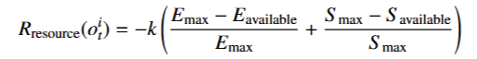
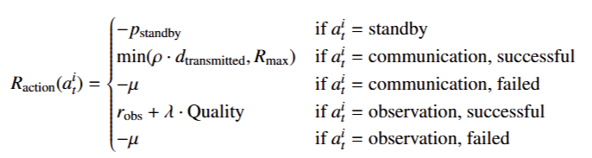
Shaped Reward Functions: Individual/Collective Evaluation – Positive/Negative Reinforcement
Observation status (M):
0 - undetected
1 - detected
2 - being observed
3 - fully observed

Slide 8
Individual Positive Reinforcement
Individual Negative Reinforcement
Collective Positive Reinforcement
Collective Negative Reinforcement
Observation status (M):
0 - undetected
1 - detected
2 - being observed
3 - fully observed
Sensitivity analysis for α:
0
0.1
0.5
1.0
2.0
5.0
α is the weight of the mission goal term

Slide 9
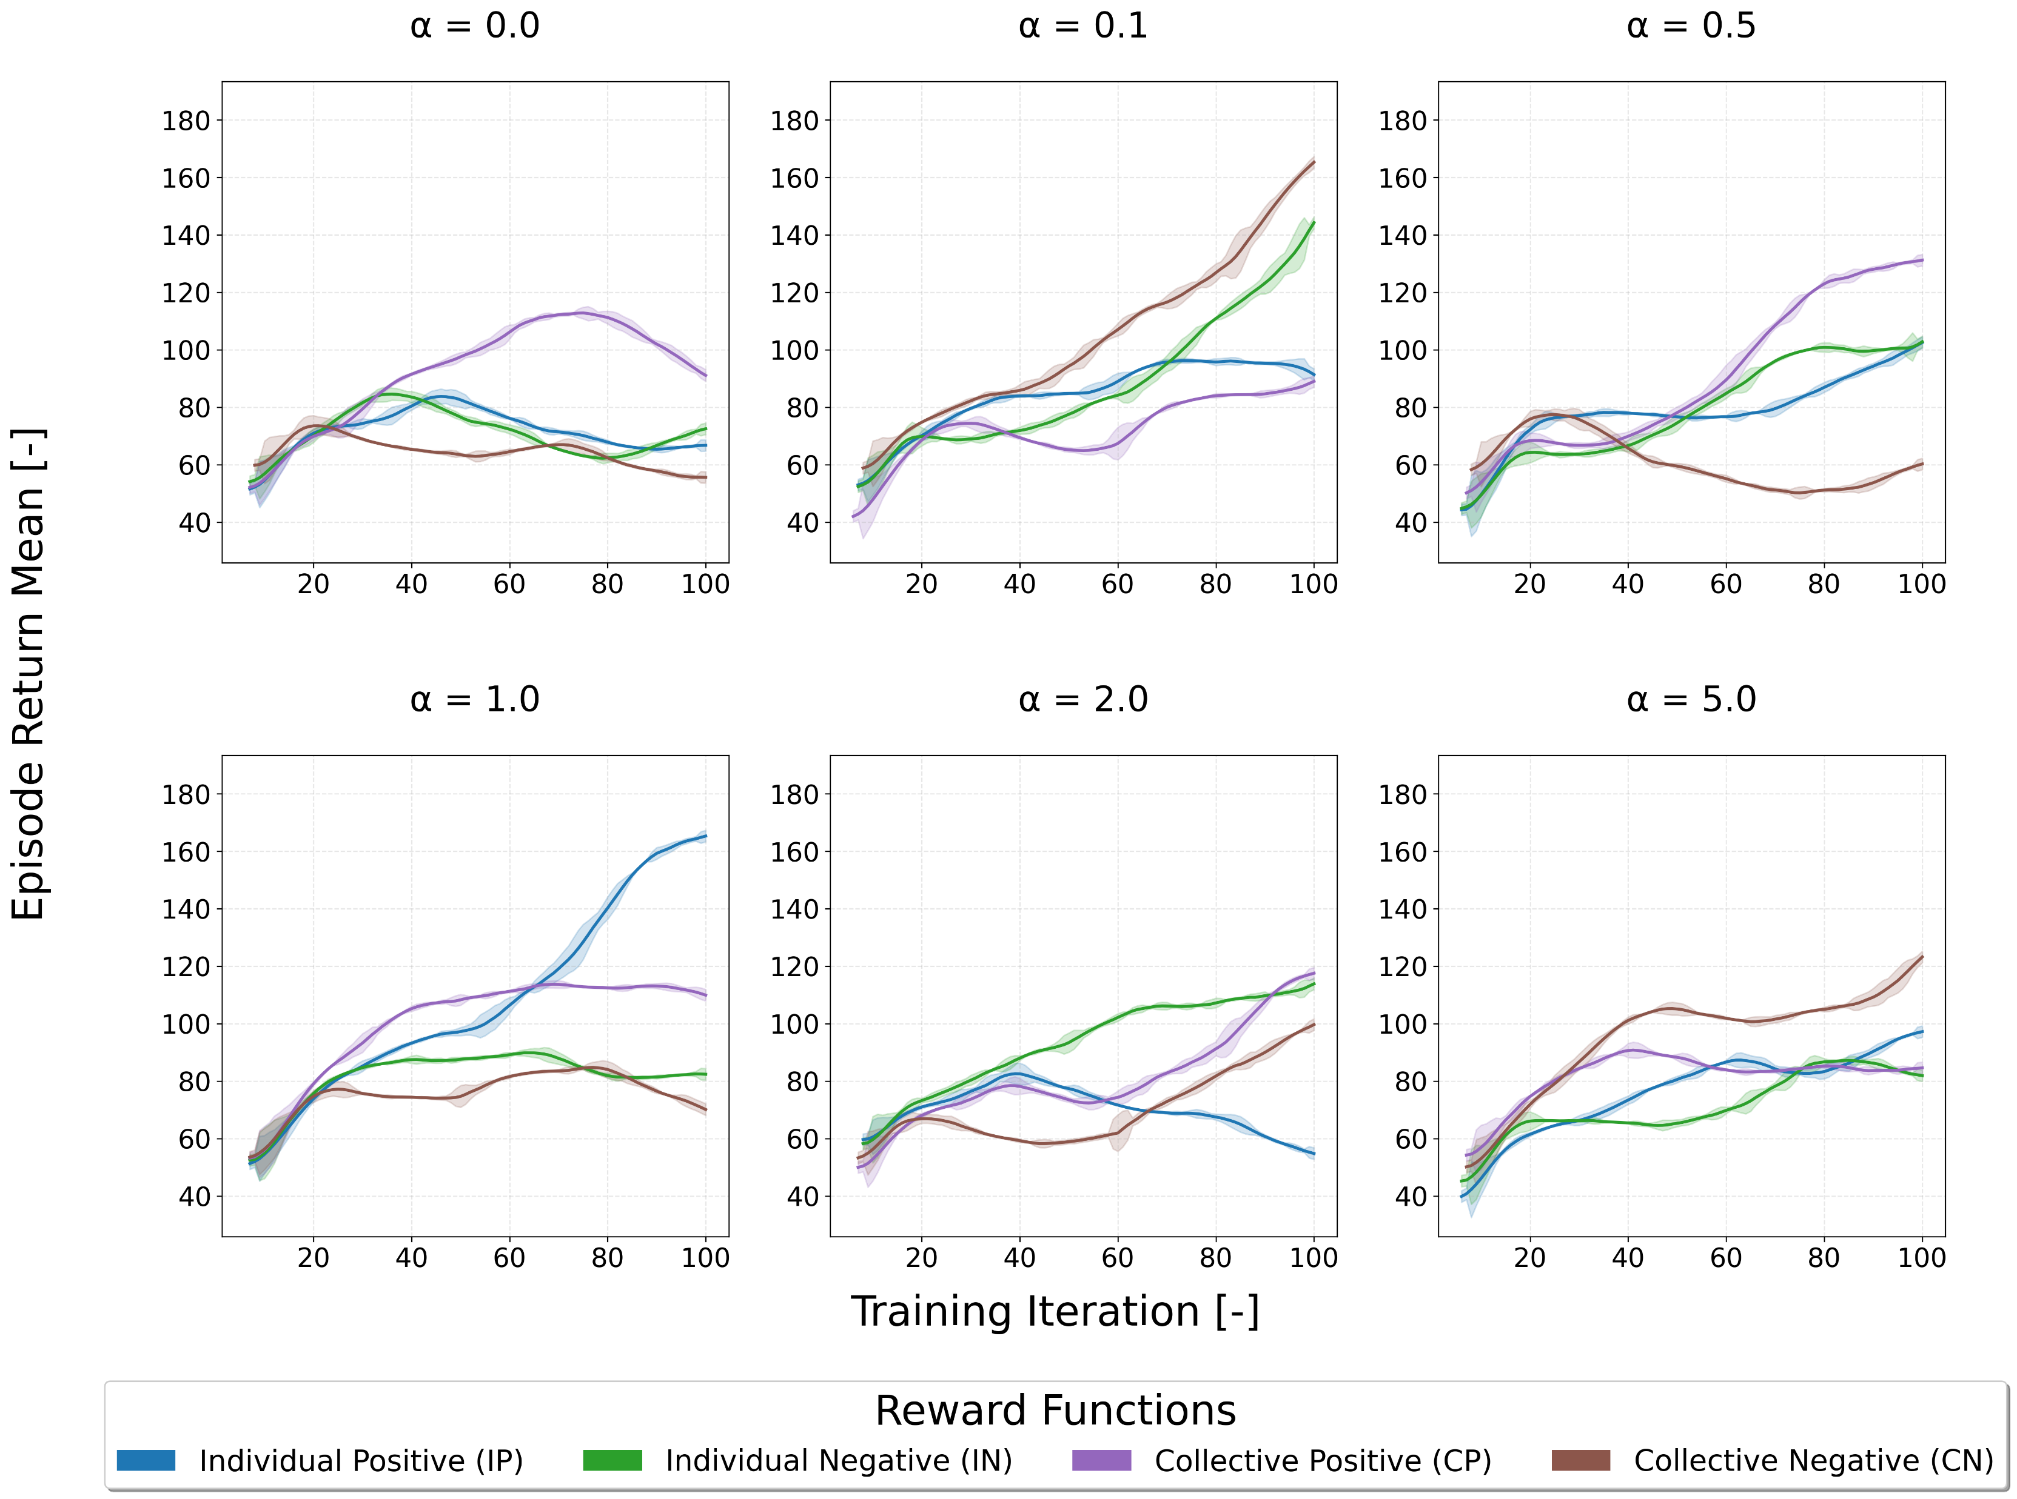
Training Results: 4 Reward Functions, 6 α values, 5 seeds
24 combinations of α and Reward Functions
All trained in a fully decentralized environment

Slide 10
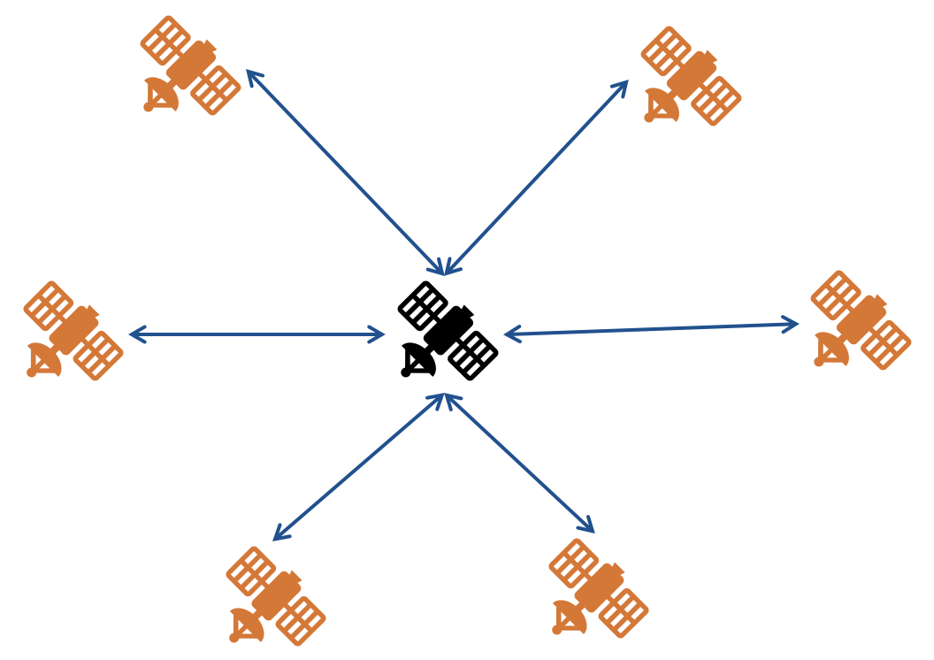
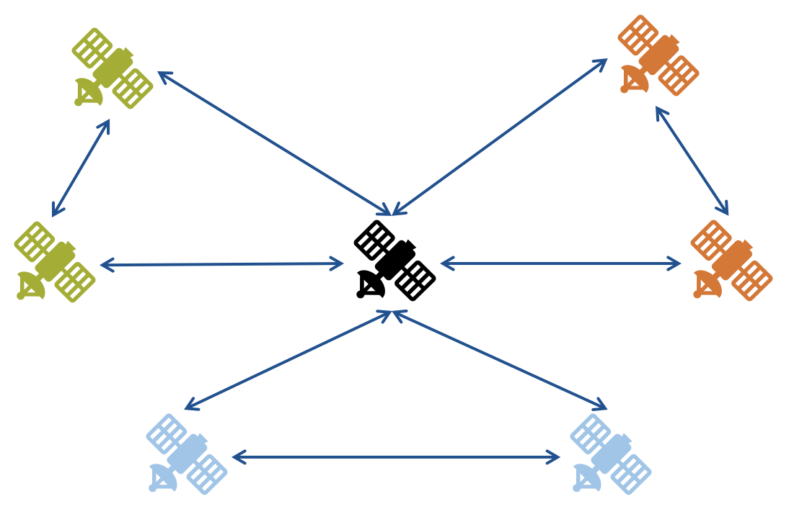
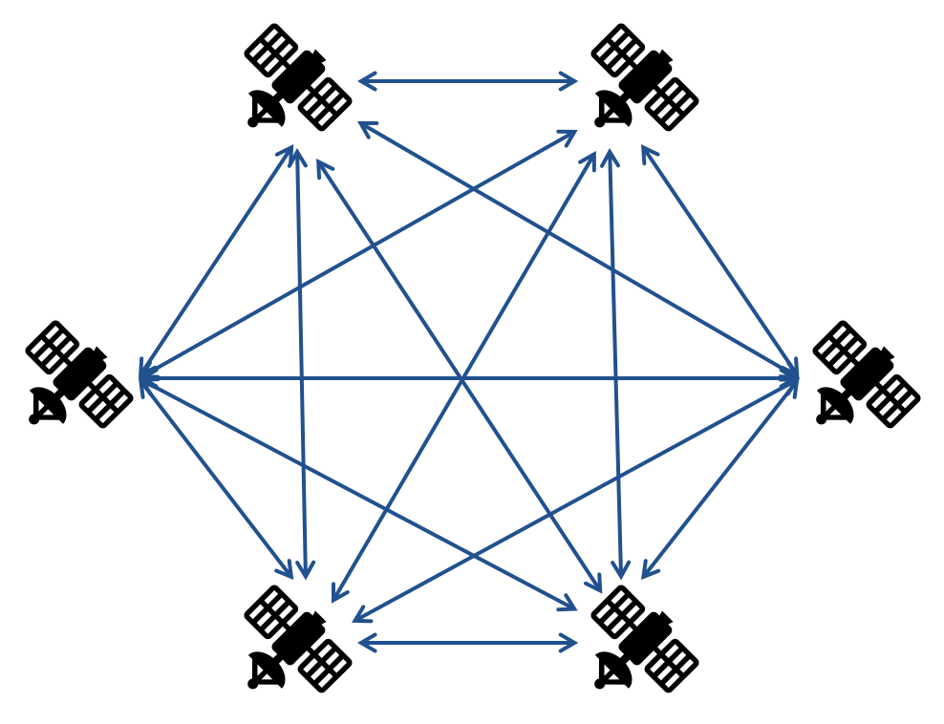
Deployed in 3 Different Coordination Topologies against 2 Centralized Exact Methods with Perfect Information
Centralized
Constrained Decentralized
Fully Decentralized
Rule-Based Method
Hierarchical strategy:
Prioritizes energy conservation if battery is under 30%
Encourages communication when storage is over 70%
Observes whenever a target is in sight
Mixed Integer Programming (MIP)
Optimization problem
Maximizes expected utility while respecting resource constraints
Simplified linear heuristics for computing each action utility

Slide 11
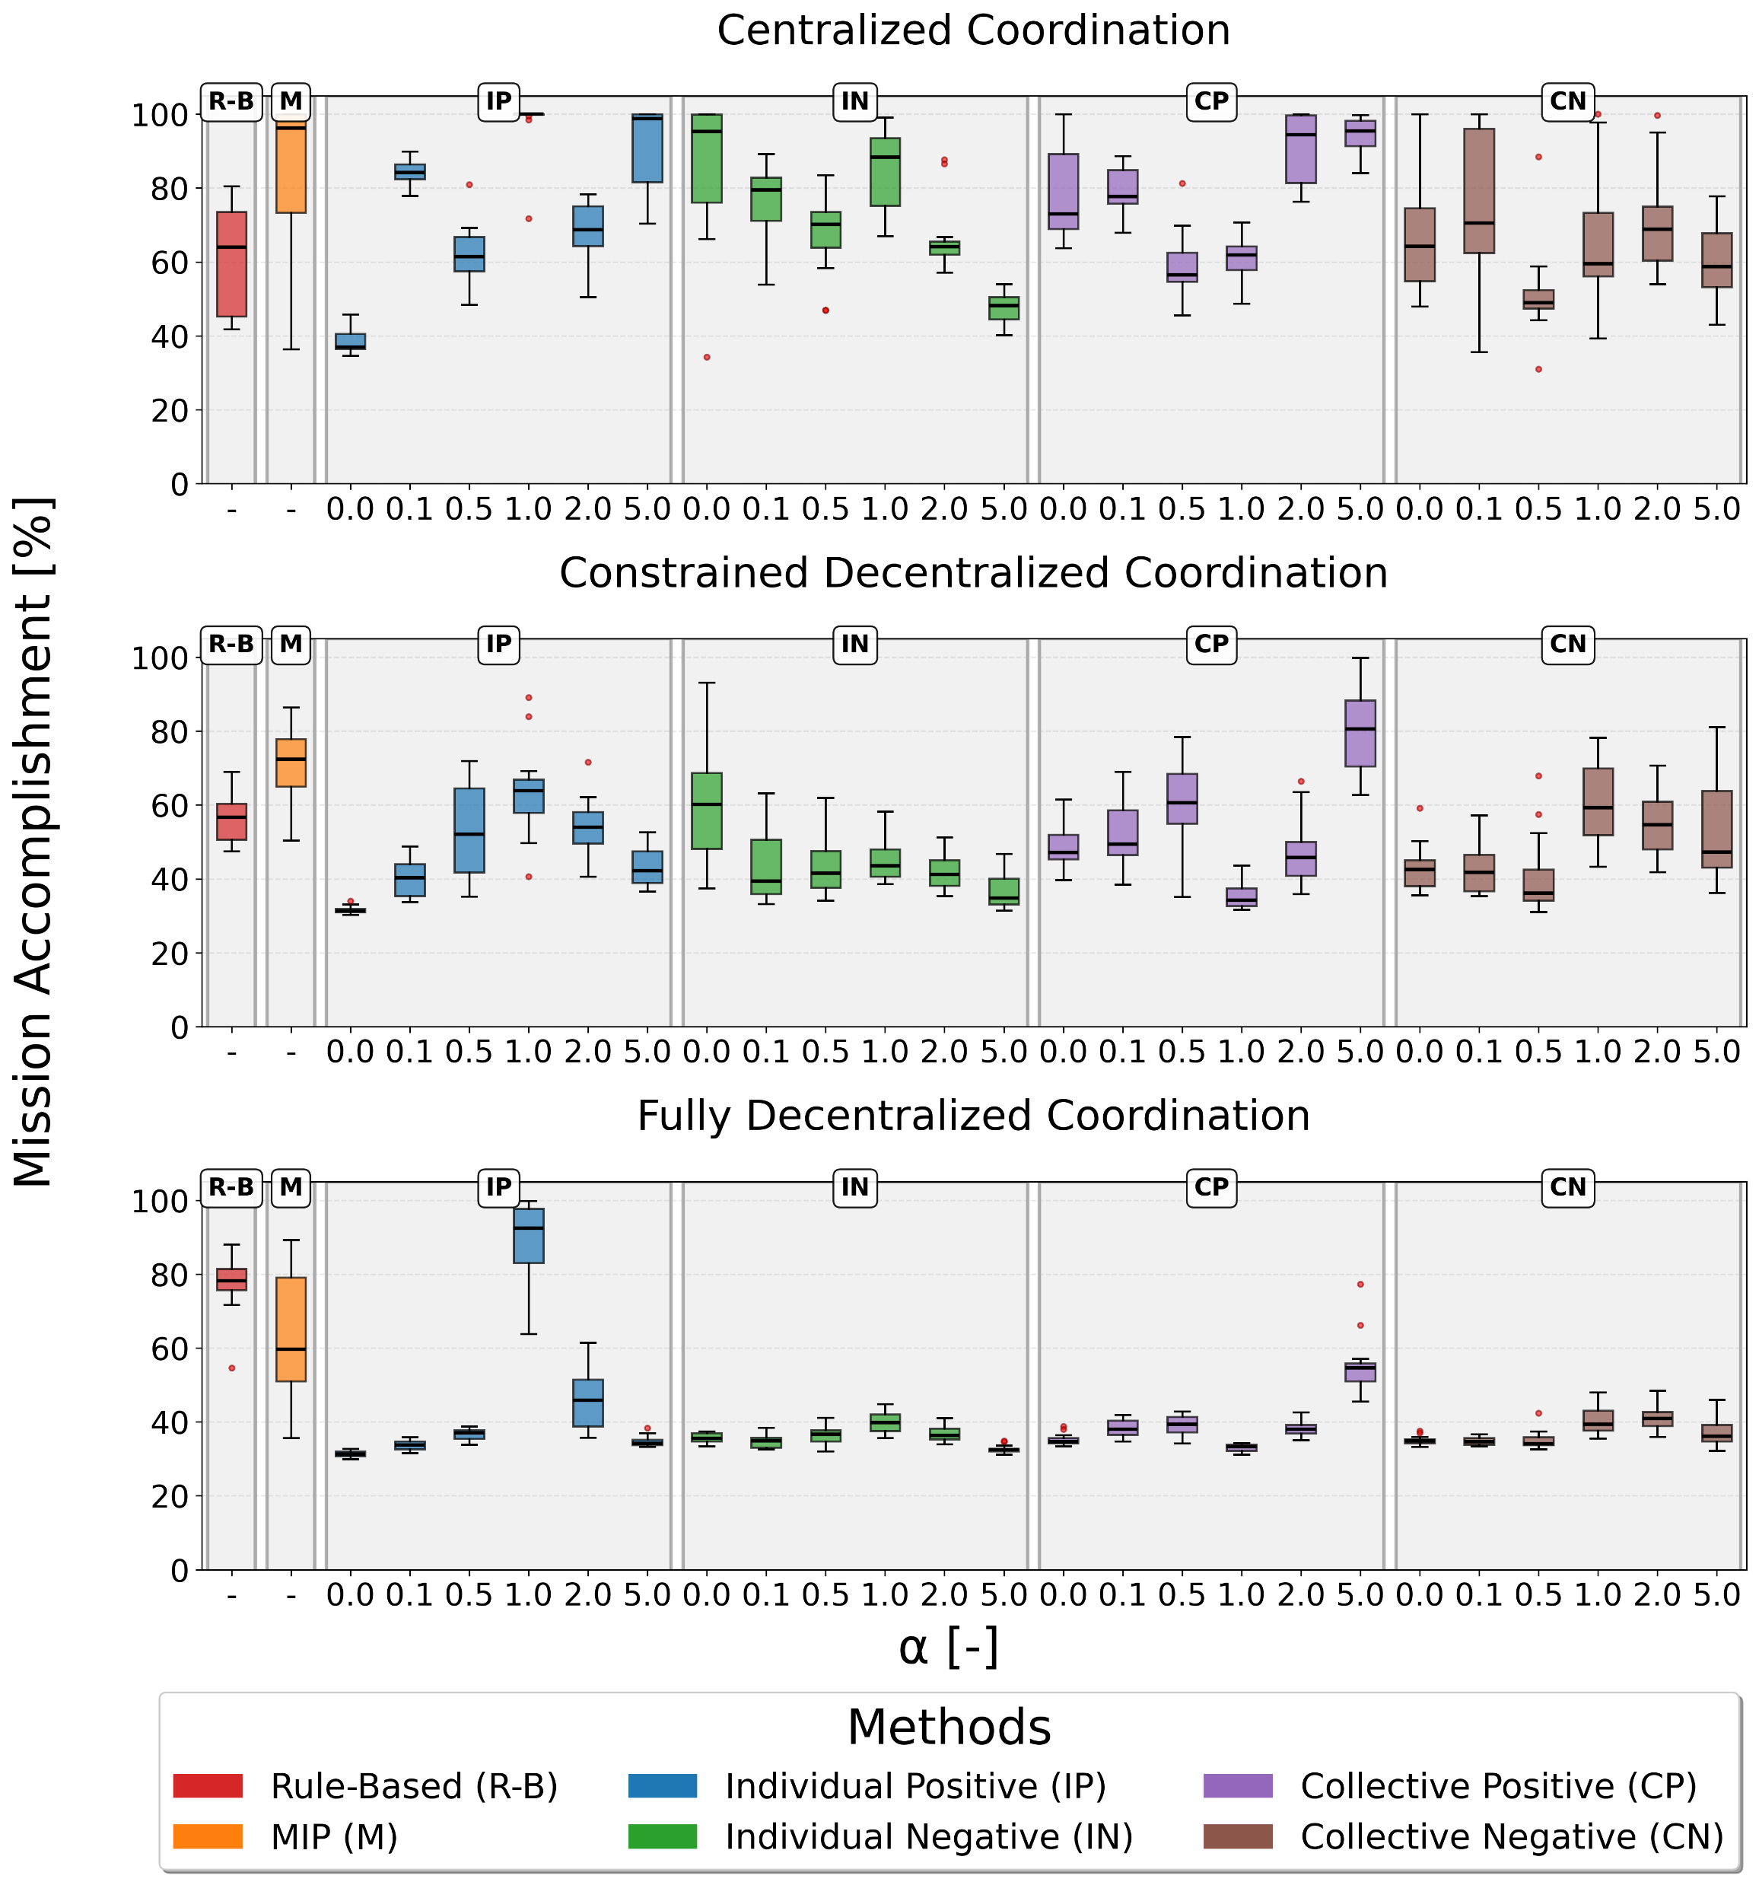
Mission Accomplishment Results
Rule-Based and MIP benchmarks have perfect information access and centralized execution
Centralized coordination obtains better results than the decentralized approaches
RL agents develop fundamental coordination strategies that are robust across different network topologies
Negative cases show more stability wrt α

Slide 12
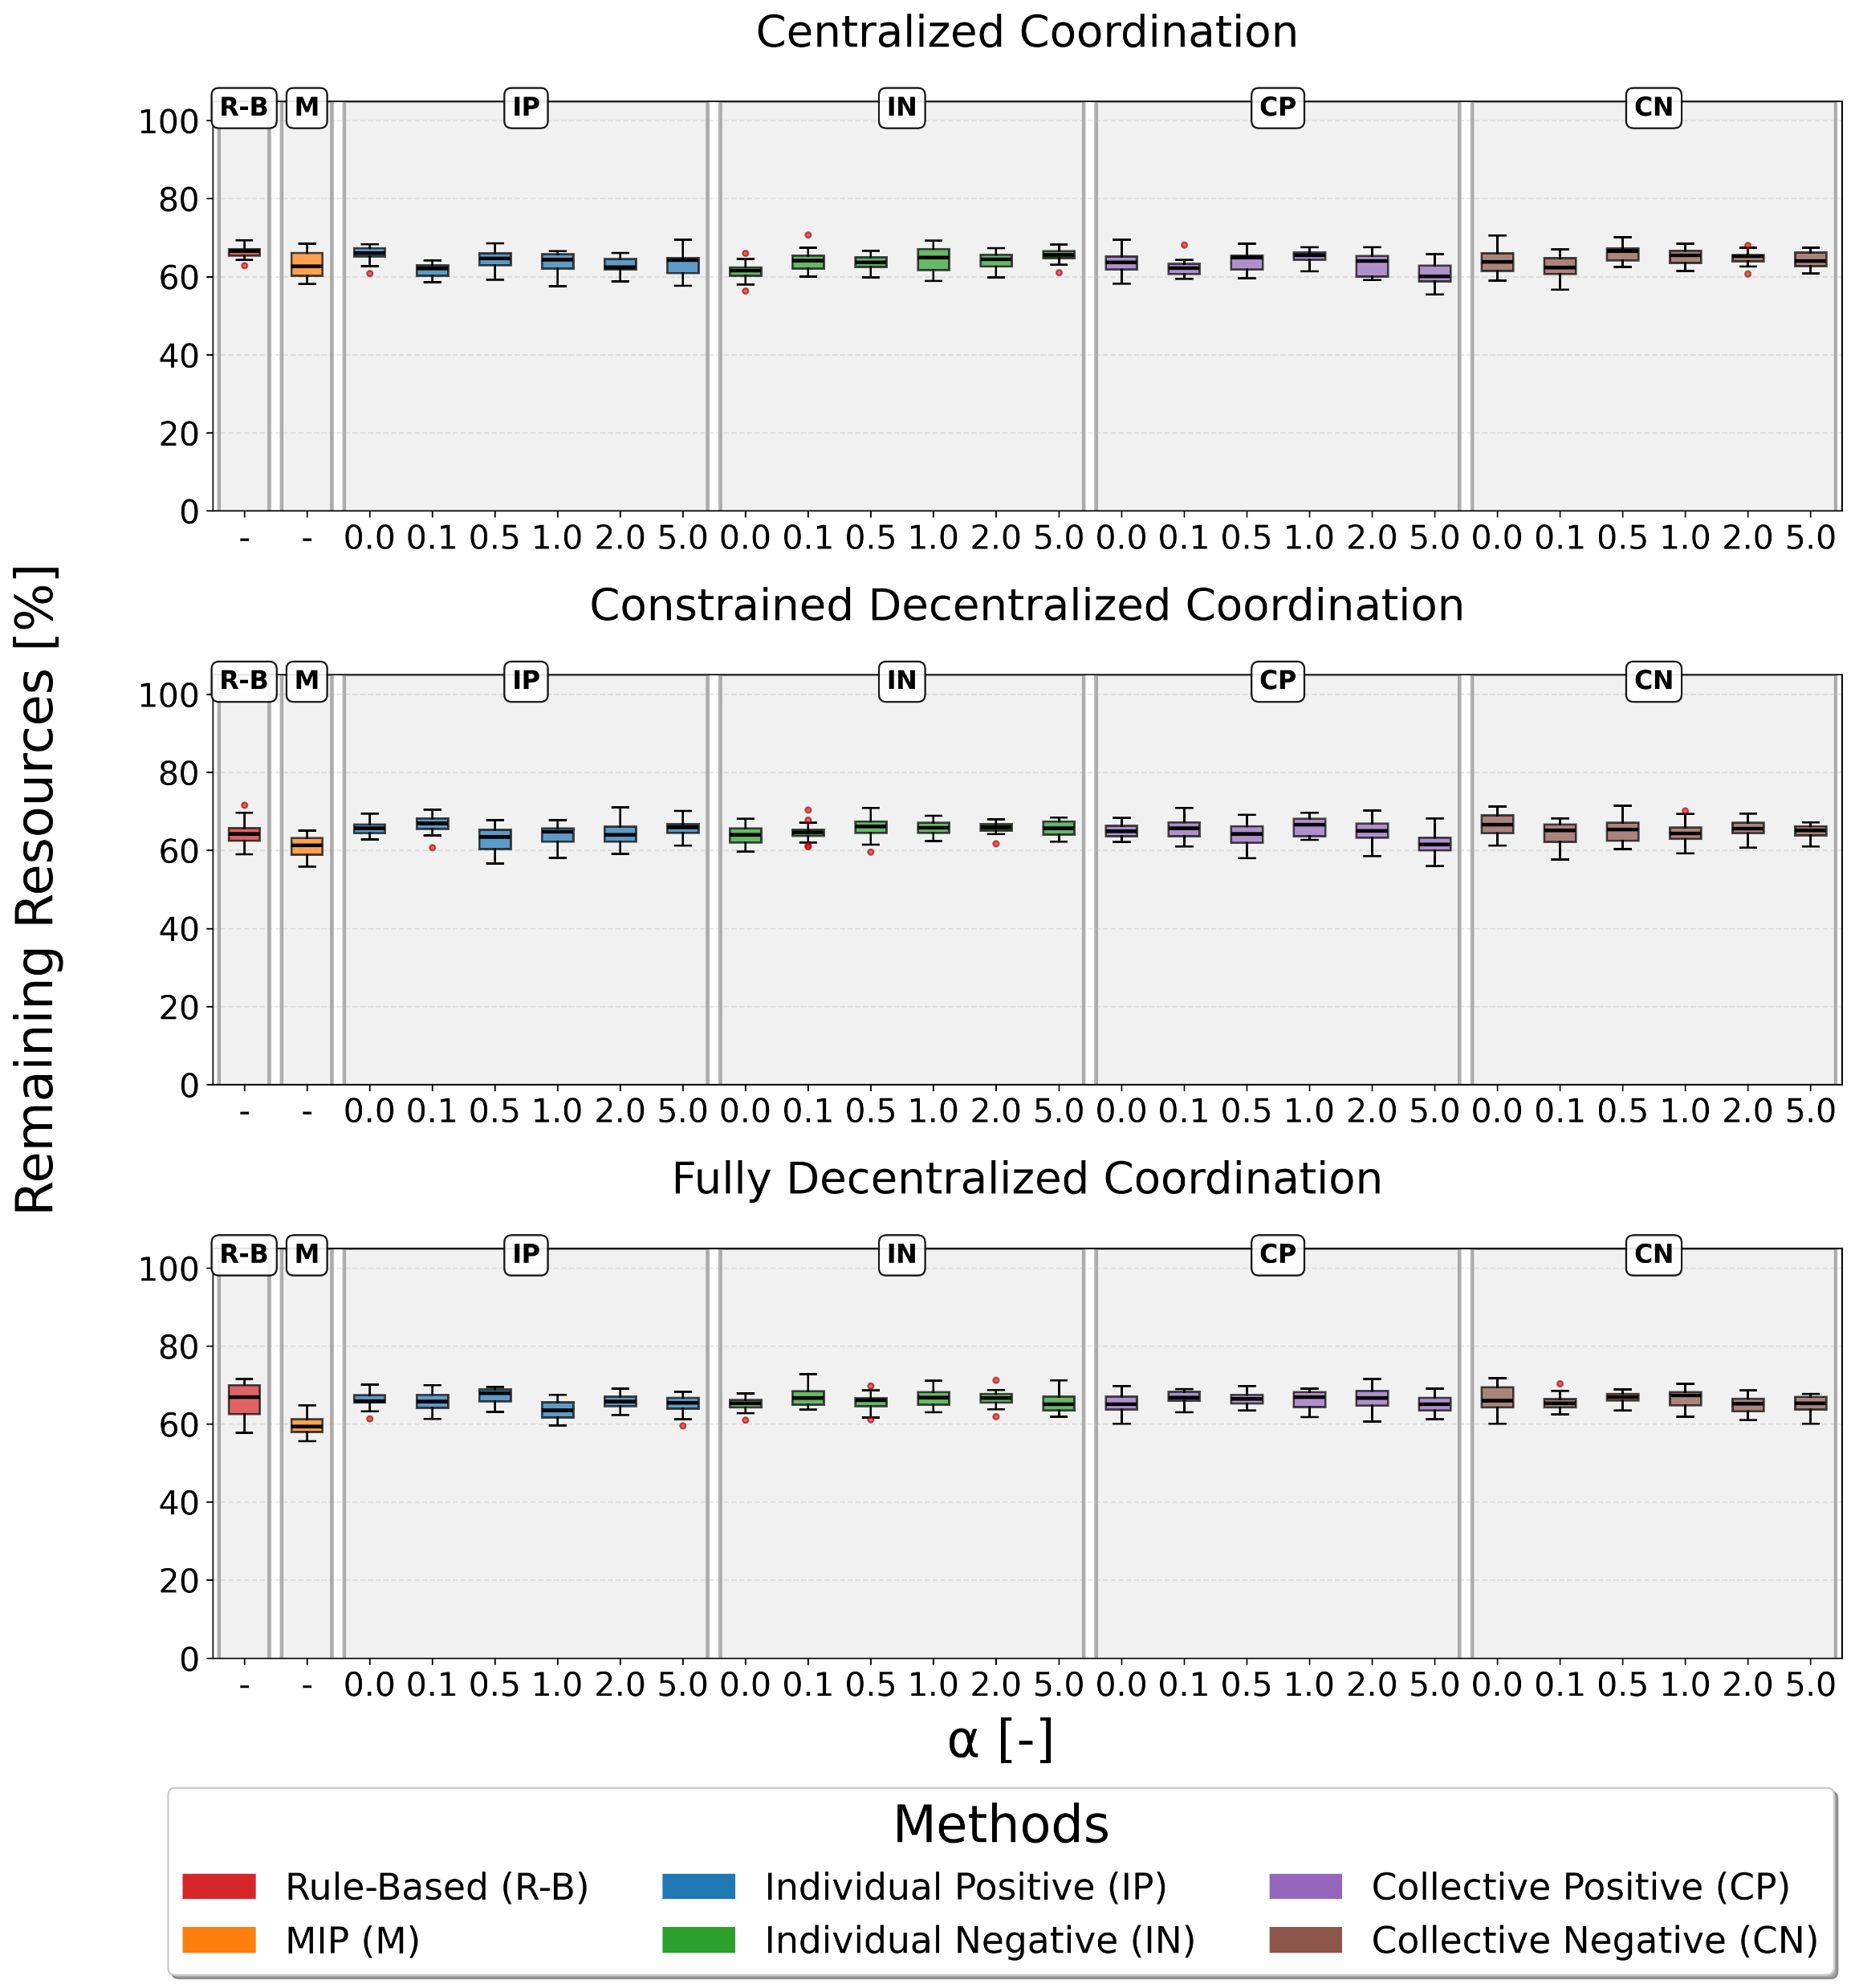
Remaining Resources After Simulation
RL approaches achieve comparable or slightly superior resource conservation
Stability of resource levels across different α scaling factors indicates effective balance learning

Slide 13
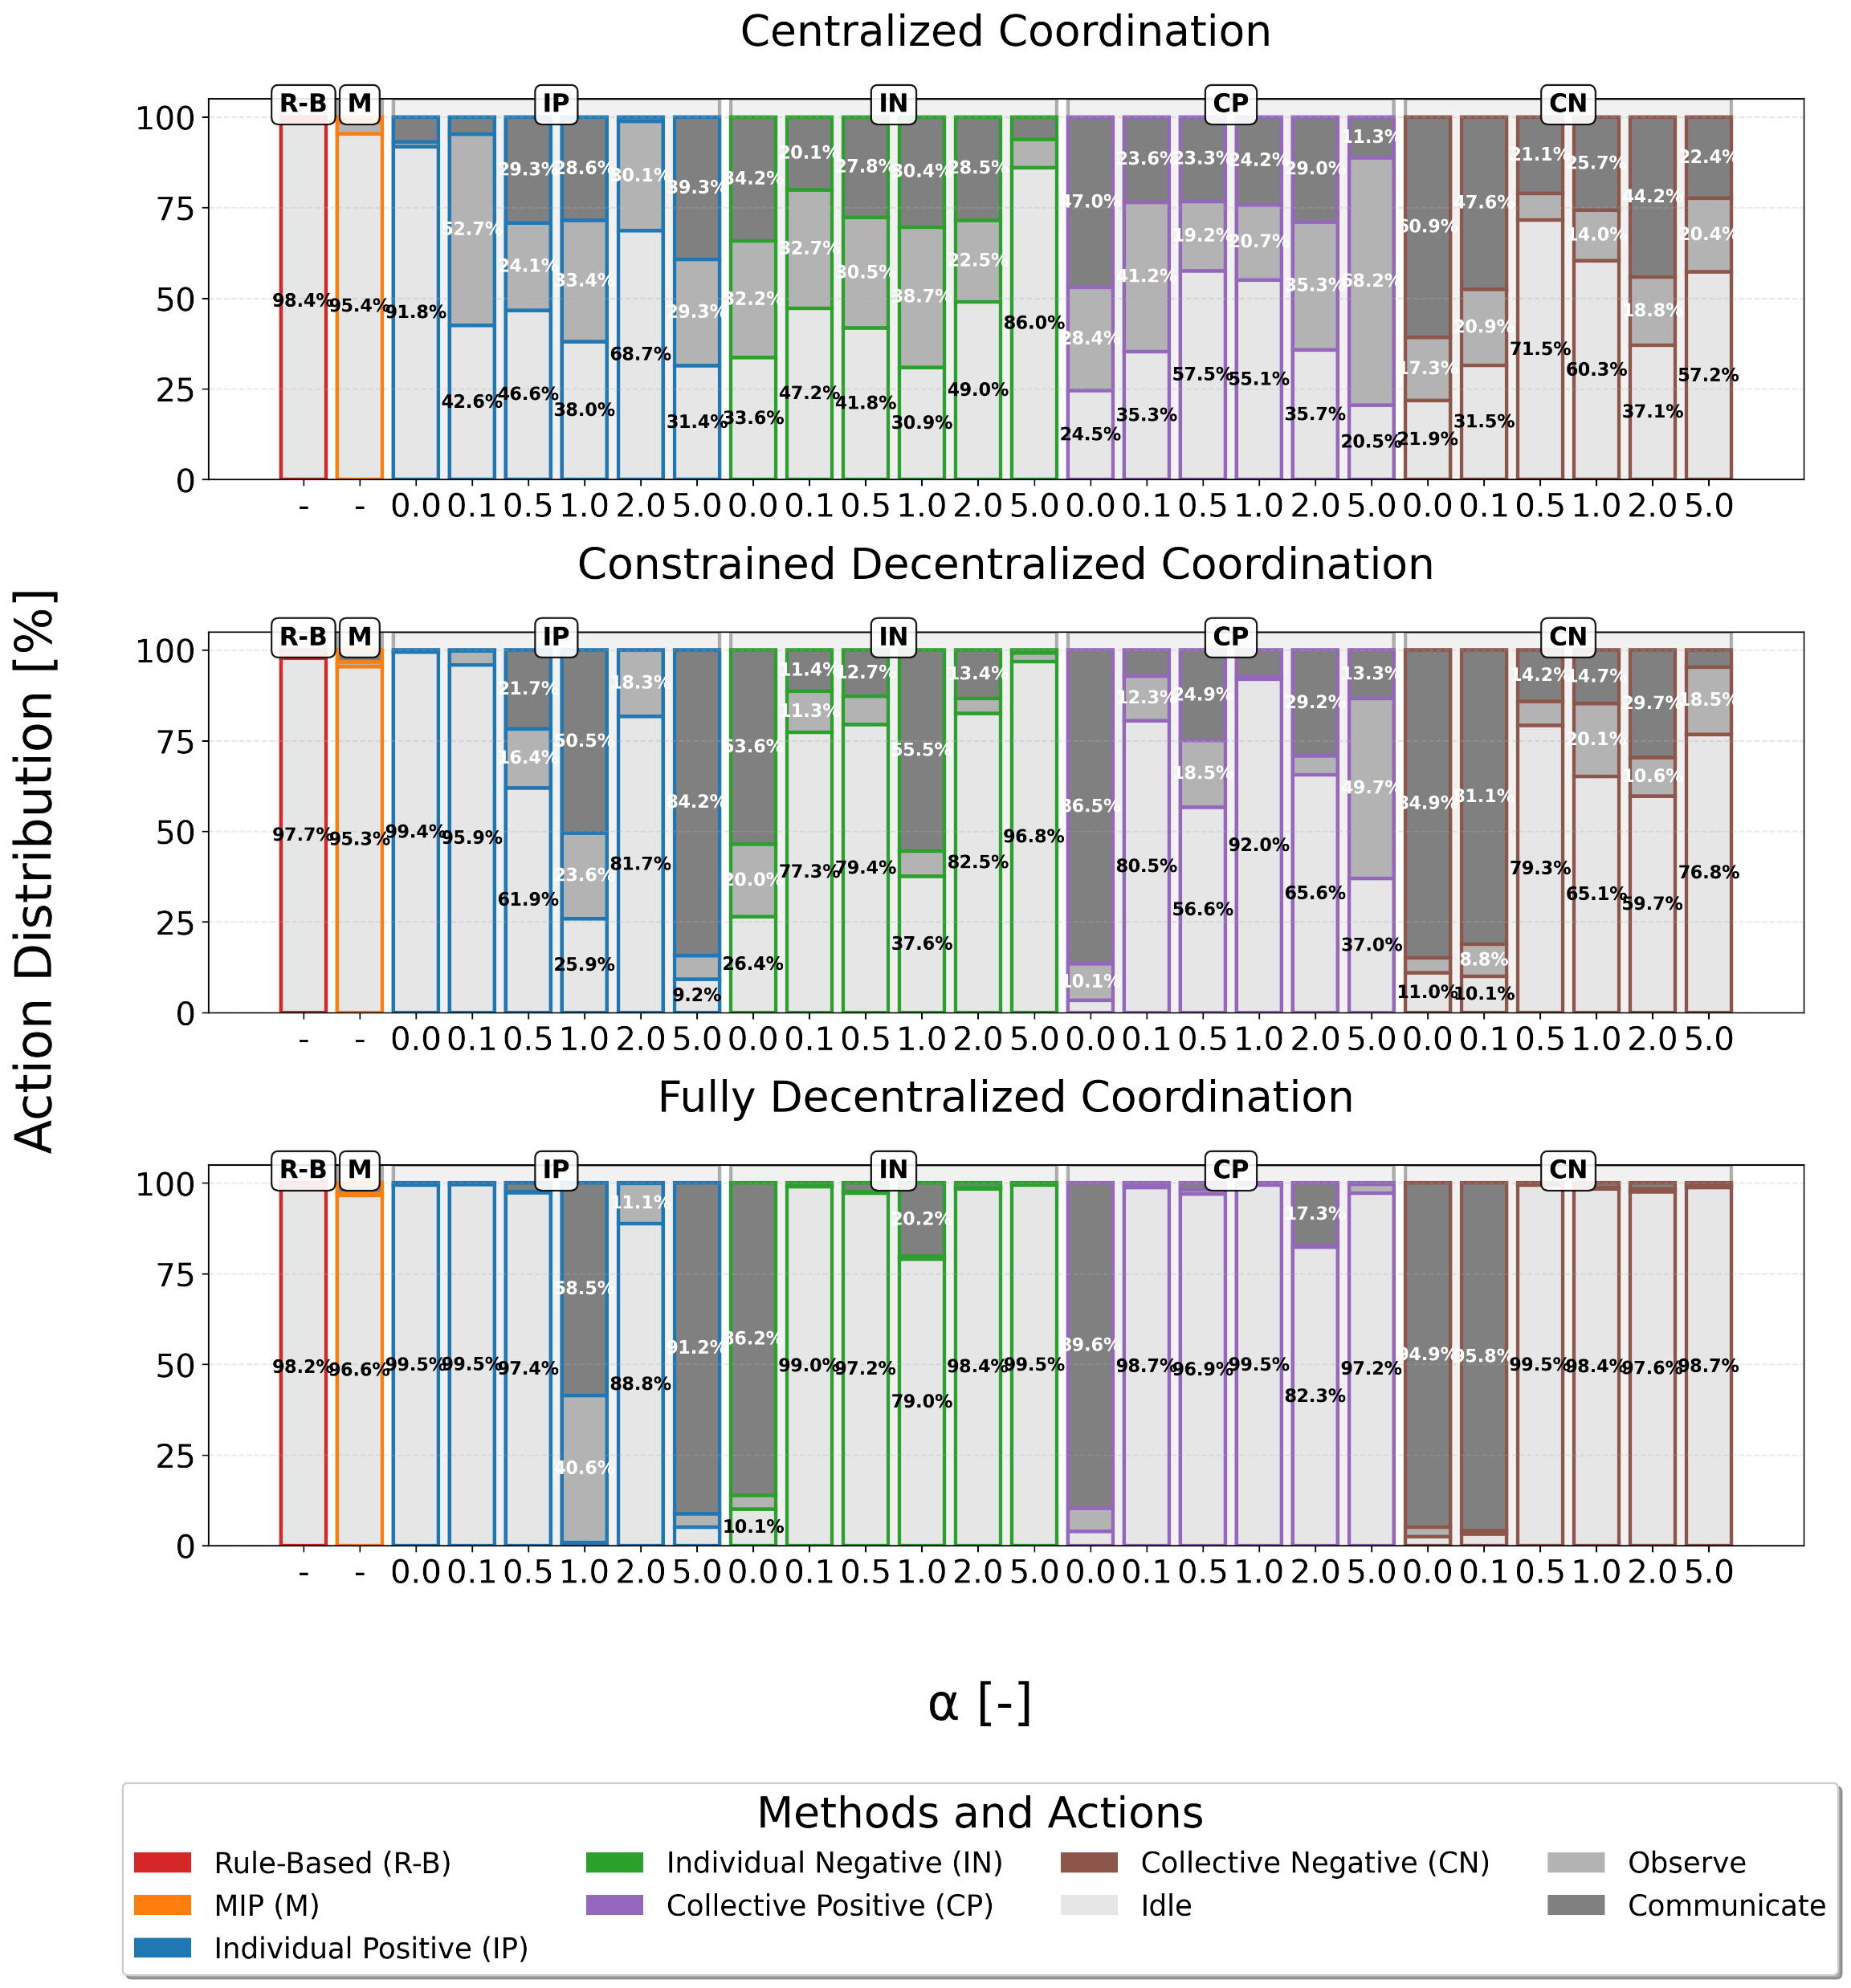
Operating Modes during the Mission
Most decentralized approaches remain in idle mode more than 95% of the mission time
More balanced performance in constrained and centralized scenarios
Ability to maintain mission-critical activities under communication limitations

Slide 14
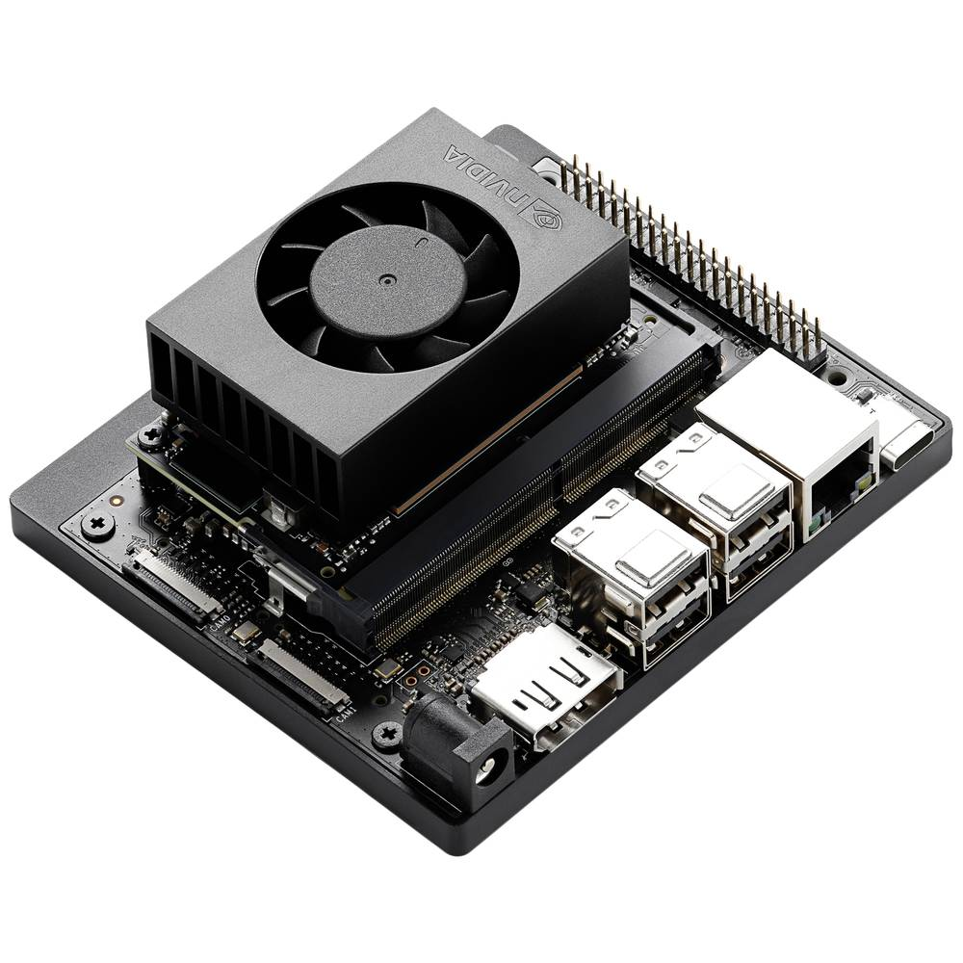
3 Key Takeaways Multi-Agent RL policies in constellation management…
learned fundamental coordination strategies that are robust across different network topologies
effectively balanced mission execution and resource preservation
can be executed onboard in microseconds
NVIDIA Jetson Orin Nano

Slide 15
Thank you for your attention!
clemente.juan@tum.de
Clemente J. Juan Oliver, MSc.
Chair of Spacecraft Systems
School of Engineering and Design
Technical University of Munich
This work was supported by the AUTOPS project, within the Bavarian Joint Research Program
of the StMWi (BayVFP), funding number MRF-2307-0004.

Slide 16
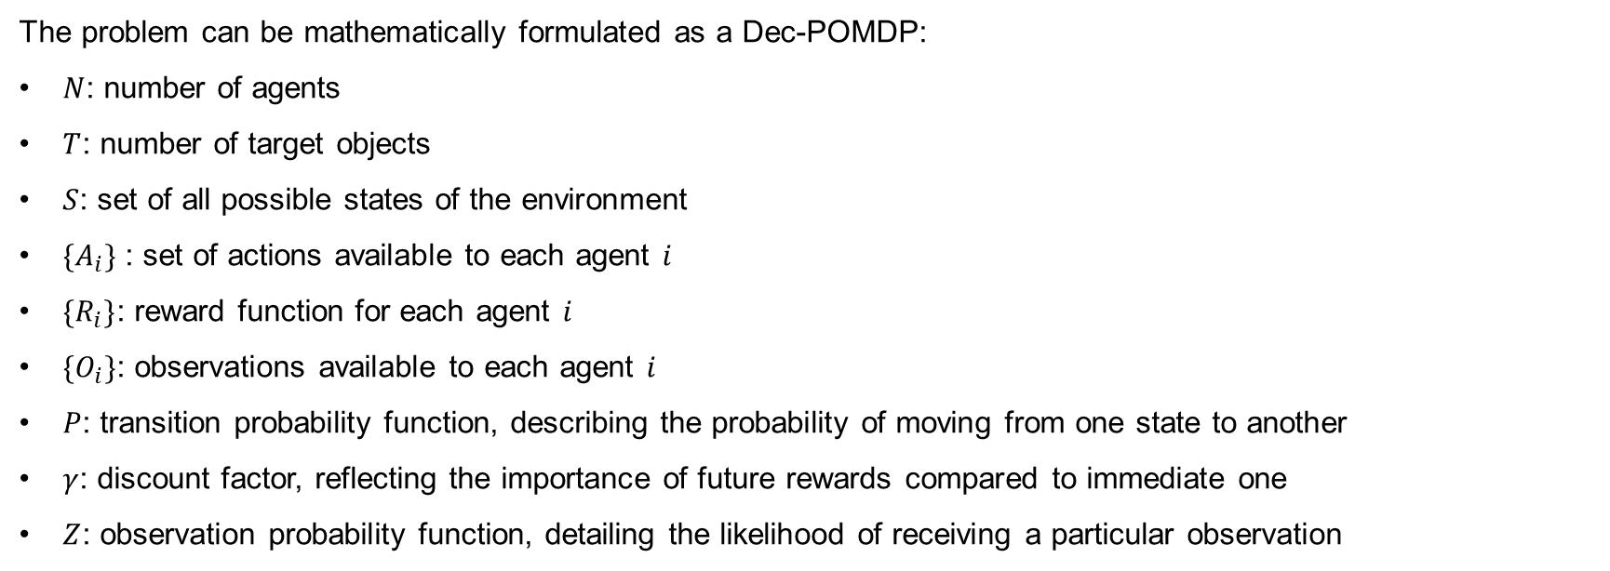
How do we integrate this as a Reinforcement Learning Problem? Decentralized Partially Observable Markov Decision Process
The problem can be mathematically formulated as a Dec-POMDP:
$N$: number of agents
$T$: number of target objects
$S$: set of all possible states of the environment
${\{A}_{i}\}$ : set of actions available to each agent $i$
${\{R}_{i}\}$: reward function for each agent $i$
${\{O}_{i}\}$: observations available to each agent $i$
$P$: transition probability function, describing the probability of moving from one state to another
$γ$: discount factor, reflecting the importance of future rewards compared to immediate one
$Z$: observation probability function, detailing the likelihood of receiving a particular observation

